Slide 1
Recon Drone
By: Stuart Redfearn, Jace Ziegler, Cole Edwards

Slide 2
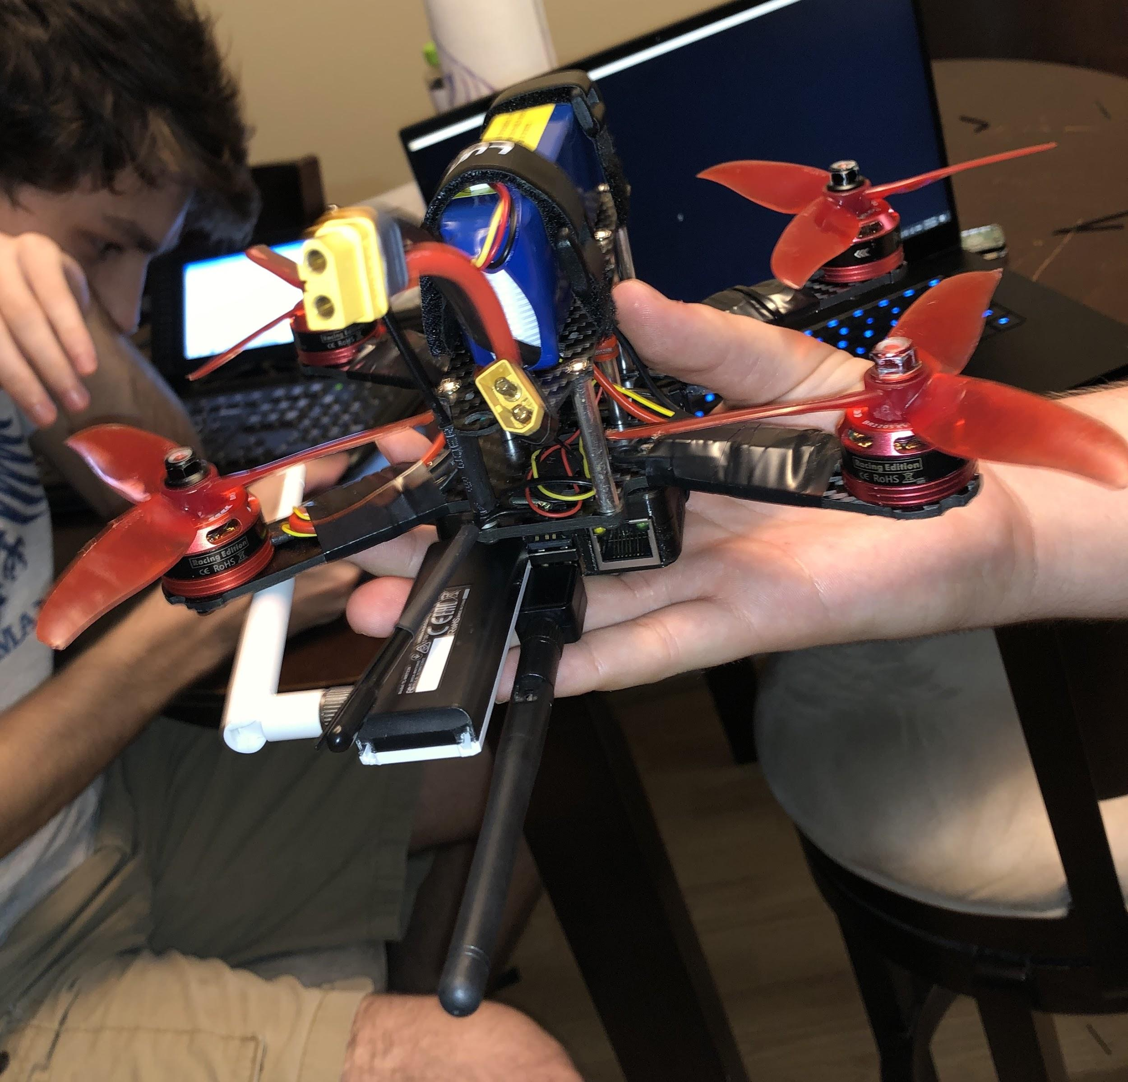
Goals
Show that unsecured WiFi is not safe
Show how networks can be abused to get information
Show a proof-of-concept idea for ranged recon

Slide 3
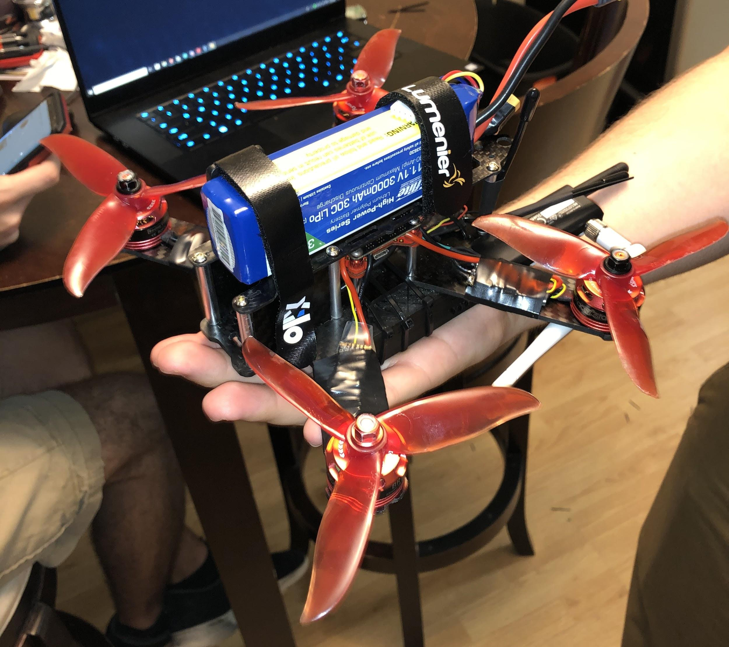
Overview of Components
One homemade drone consisting of:
4 Racestar motors
1 Raspberry Pi 3b+
1 Fortini f4 osd flight controller
4 electronic speed controller
1 WiFi adapter
1 E-flite 11.1V battery, 3000 mAh
1 Receiver
1 Transmitter
1 Power distribution Board
Ground Station consists of:
Raspberry Pi 3b+
Screen, Keyboard, Mouse

Slide 4
How it Works
SSH into the Raspberry Pi
Move drone to desired location
Raspberry Pi will connect to a WiFi
Airodump gathers the information
Run Airgraph-ng to create the image
Send the image to the Ground Station

Slide 5

Demo

Slide 6
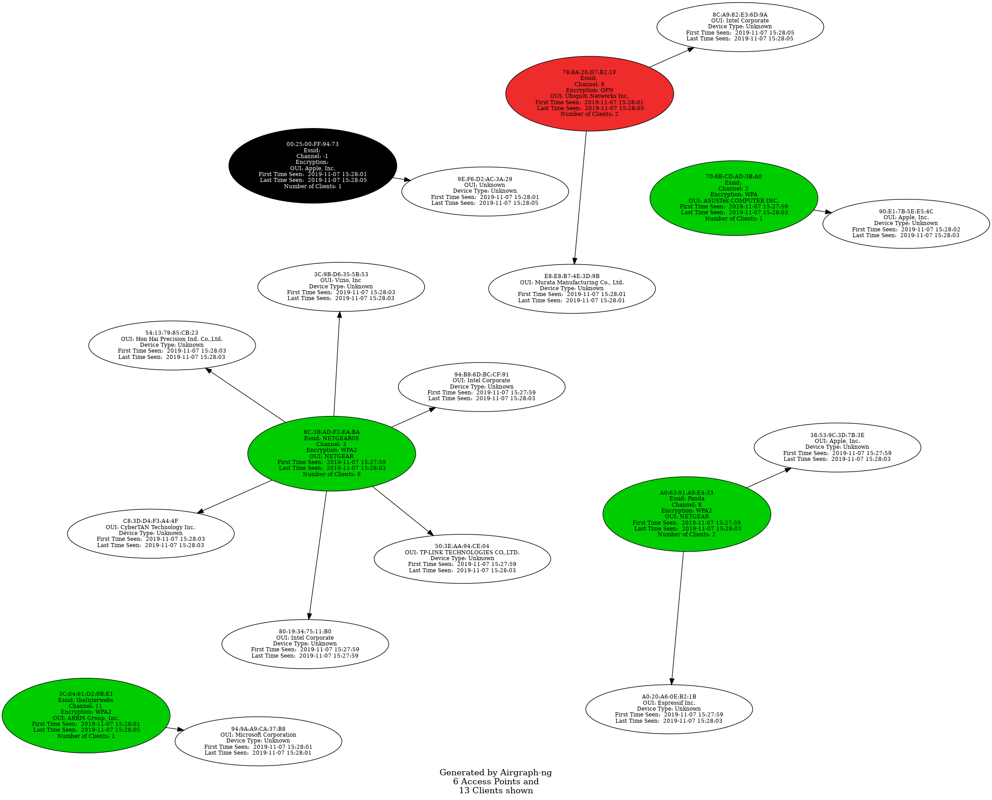
Graph

Slide 7
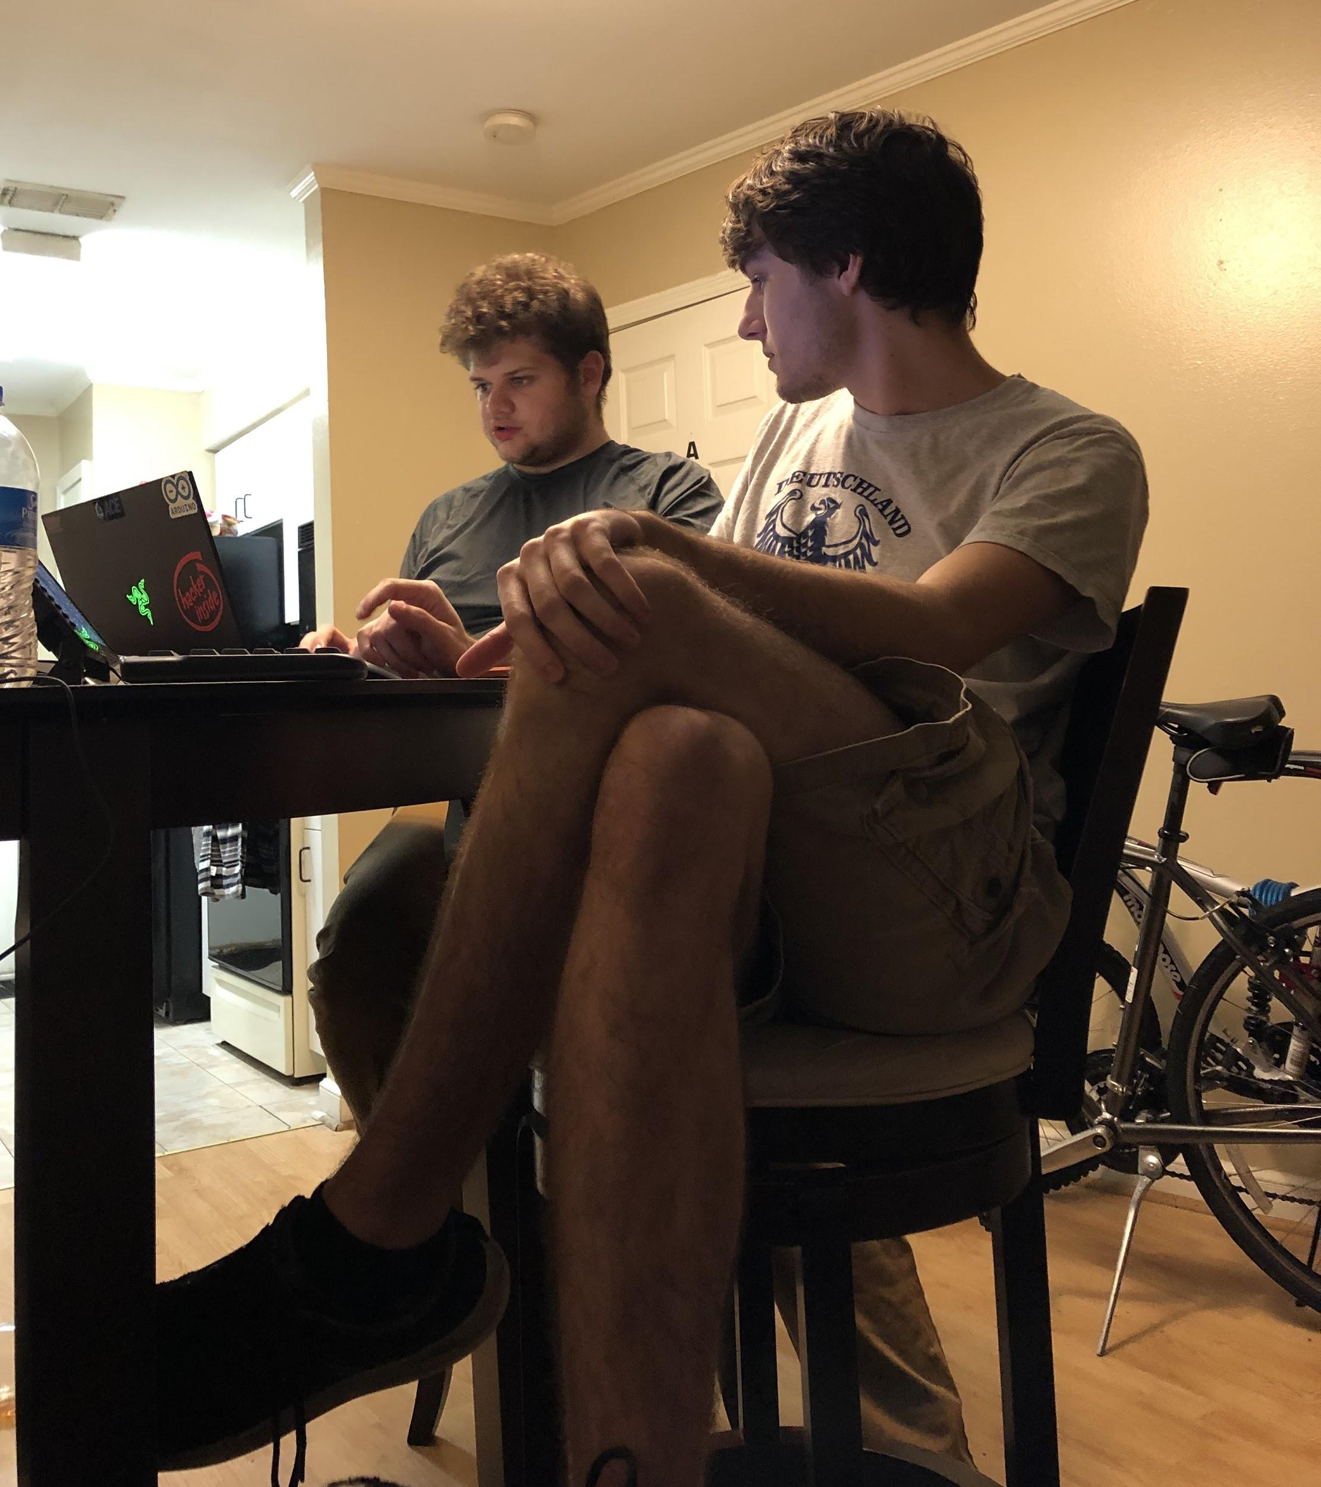
Lessons Learned
Setup of Kali Linux, GitHub, Terminal
Different Cyber Attacks
How secure WiFi’s are and aren’t
Risks of being on an unsecure WiFi
Code in python to Terminal
Repurposing old electronics

Slide 8
Future Development
Nothing, we do not want a felony

Slide 9
Future Development (Continued)
Addition of camera
Implementation of more tools
Better wireless card
Different cyber attacks
Hover Mode for the drone

